Slide 1
Picturing Distributions with Graphs
BPS chapter 1
© 2013 W.H. Freeman and Company

Slide 2
Individuals and Variables
Airport administrators take a sample of airline baggage and record the number of bags that weigh more than 75 pounds. What is the individual?
Number of bags weighing more than 75 pounds.
Average weight of the bags.
Each piece of baggage.
The airport administrators.

Slide 3
Individuals and Variables (answer)
Airport administrators take a sample of airline baggage and record the number of bags that weigh more than 75 pounds. What is the individual?
Number of bags weighing more than 75 pounds.
Average weight of the bags.
Each piece of baggage.
The airport administrators.

Slide 4
Individuals and Variables
Airport administrators take a sample of airline baggage and record the number of bags that weigh more than 75 pounds. What is the variable of interest?
Whether the baggage weighs greater than 75 pounds (Yes or No).
Average weight of the bags.
Each piece of baggage.
The airport administrators.

Slide 5
Individuals and Variables (answer)
Airport administrators take a sample of airline baggage and record the number of bags that weigh more than 75 pounds. What is the variable of interest?
Whether the baggage weighs greater than 75 pounds (Yes or No).
Average weight of the bags.
Each piece of baggage.
The airport administrators.

Slide 6
Individuals and Variables
In a study of commuting patterns of people in a large metropolitan area, respondents were asked to report the time they took to travel to their work on a specific day of the week. What is the individual?
Travel time.
A person.
Day of the week.
City in which they lived.

Slide 7
Individuals and Variables (answer)
In a study of commuting patterns of people in a large metropolitan area, respondents were asked to report the time they took to travel to their work on a specific day of the week. What is the individual?
Travel time.
A person.
Day of the week.
City in which they lived.

Slide 8
Individuals and Variables
In a study of commuting patterns of people in a large metropolitan area, respondents were asked to report the time they took to travel to their work on a specific day of the week. What is the variable of interest?
Travel time.
A person.
Day of the week.
City in which they lived.

Slide 9
Individuals vs. variables (answer)
In a study of commuting patterns of people in a large metropolitan area, respondents were asked to report the time they took to travel to their work on a specific day of the week. What is the variable of interest?
Travel time.
A person.
Day of the week.
City in which they lived.

Slide 10
Individuals and Variables
Is the variable “monthly rainfall in Michigan” a categorical or quantitative variable?
categorical
quantitative

Slide 11
Individuals and Variables (answer)
Is the variable “monthly rainfall in Michigan” a categorical or quantitative variable?
categorical
quantitative

Slide 12
Individuals and Variables
If we asked people to report their “weight,” would that variable be considered a categorical or quantitative variable?
categorical
quantitative

Slide 13
Individuals and Variables(answer)
If we asked people to report their “weight,” would that variable be considered a categorical or quantitative variable?
categorical
quantitative

Slide 14
Individuals and Variables
We ask people whether their weight is underweight, normal, overweight, or obese. Is this variable categorical or quantitative?
categorical
quantitative

Slide 15
Individuals and Variables (answer)
We ask people whether their weight is underweight, normal, overweight, or obese. Is this variable categorical or quantitative?
categorical
quantitative

Slide 16
Individuals and Variables
A survey involving 35 questions was given to a sample of 200 students attending a university with an enrollment of 10,000. How many individuals do the data describe?
35
200
10,000
impossible to say

Slide 17
Individuals and Variables (answer)
A survey involving 35 questions was given to a sample of 200 students attending a university with an enrollment of 10,000. How many individuals do the data describe?
35
200
10,000
impossible to say

Slide 18
Individuals and Variables
A survey involving 35 questions was given to a sample of 200 students attending a university with an enrollment of 10,000. How many variables do the data contain?
35
200
35 × 200
35 × 10,000

Slide 19
Individuals and Variables (answer)
A survey involving 35 questions was given to a sample of 200 students attending a university with an enrollment of 10,000. How many variables do the data contain?
35
200
35 × 200
35 × 10,000

Slide 20
Individuals and Variables
What type of data is produced by the answer choices for this question?
categorical
quantitative
How many times have you accessed the Internet this week?
None
Once or twice
Three or four times
More than four times

Slide 21
Individuals and Variables (answer)
What type of data is produced by the answer choices for this question?
categorical
quantitative
How many times have you accessed the Internet this week?
None
Once or twice
Three or four times
More than four times

Slide 22
Individuals and Variables
A survey asks 200 students how much they spend on textbooks this semester. What would the distribution of these textbook expenditures tell you?
who the students were
how the students were selected
that the costs were measured in dollars
how frequently the various expenditures occurred in the data set

Slide 23
Individuals and Variables (answer)
A survey asks 200 students how much they spend on textbooks this semester. What would the distribution of these textbook expenditures tell you?
who the students were
how the students were selected
that the costs were measured in dollars
how frequently the various expenditures occurred in the data set

Slide 24
Categorical Variables
For data involving answers to the following question, what is the BEST method of displaying the data?
bar graph
boxplot
histogram
scatterplot
How many times have you accessed the Internet this week?
None
Once or twice
Three or four times
More than four times

Slide 25
Categorical Variables (answer)
For data involving answers to the following question, what is the BEST method of displaying the data?
bar graph
boxplot
histogram
scatterplot
How many times have you accessed the Internet this week?
None
Once or twice
Three or four times
More than four times

Slide 26
Categorical Variables
A pie chart represents counts or percentages by _______________.
labels of pie slices
location of pie slices
colors of pie slices
areas of pie slices

Slide 27
Categorical Variables (answer)
A pie chart represents counts or percentages by _______________.
labels of pie slices
location of pie slices
colors of pie slices
areas of pie slices

Slide 28
Categorical Variables
In a bar chart, what graphical element is proportional to the number in each category?
height of the bar
horizontal position of the category
darkness of the shading of the bar
label of the category

Slide 29
Categorical Variables (answer)
In a bar chart, what graphical element is proportional to the number in each category?
height of the bar
horizontal position of the category
darkness of the shading of the bar
label of the category

Slide 30
Categorical Variables
The purpose of pie charts and bar charts is to _______________.
hide the data from the audience
impress the audience with interesting colors and shapes
help the audience grasp the distribution of the data quickly
communicate the nature of the categories

Slide 31
Categorical Variables (answer)
The purpose of pie charts and bar charts is to _______________.
hide the data from the audience
impress the audience with interesting colors and shapes
help the audience grasp the distribution of the data quickly
communicate the nature of the categories

Slide 32
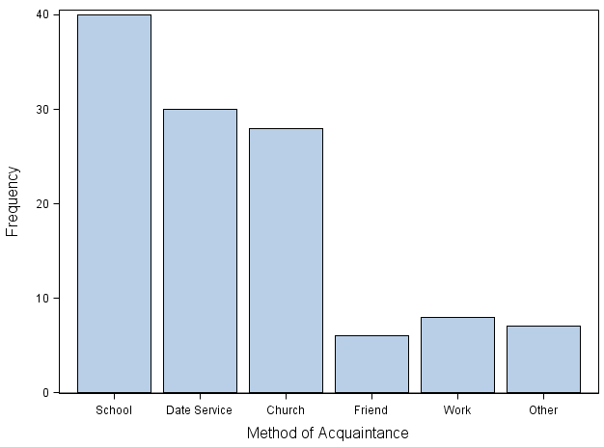
Categorical Variables
Married respondents in a survey were asked how they met their spouse. According to the bar chart below, how many respondents met their spouse through a dating service?
2
20
30
70

Slide 33
Categorical Variables (answer)
Married respondents in a survey were asked how they met their spouse. According to the bar chart below, how many respondents met their spouse through a dating service?
2
20
30
70

Slide 34
Quantitative Variables
Look at the following histogram. How many baseball players report a salary of less than $1,441,000?
50
170
220
350

Slide 35
Quantitative Variables (answer)
Look at the following histogram. How many baseball players report a salary of less than $1,441,000?
50
170
220
350

Slide 36
Quantitative Variables
Look at the following histogram of salaries of baseball players. What shape would you say the data take?
Bi-modal
Left-skewed
Right-skewed
Symmetric
Uniform

Slide 37
Quantitative Variables (answer)
Look at the following histogram of salaries of baseball players. What shape would you say the data take?
Bi-modal
Left-skewed
Right-skewed
Symmetric
Uniform

Slide 38
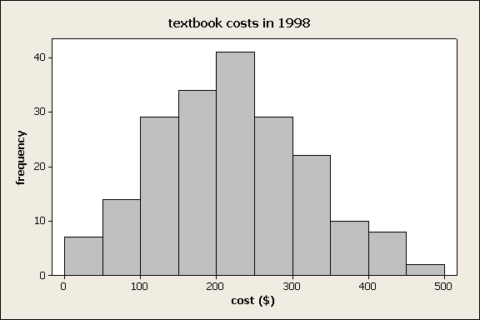
Quantitative Variables
Considering this histogram, about how many students in the survey paid more than $250 for textbooks?
29
47
62
71

Slide 39
Quantitative Variables (answer)
Considering this histogram, about how many students in the survey paid more than $250 for textbooks?
29
47
62
71

Slide 40
Quantitative Variables
In the dataset represented by the following stemplot, how many times does the number “28” occur? Leaf unit = 1.0.
0
1
3
4
0 9
246999
111134567888999
000112222345666699
001445
0014
7
3

Slide 41
Quantitative Variables (answer)
In the dataset represented by the following stemplot, how many times does the number “28” occur? Leaf unit = 1.0.
0
1
3
4
0 9
246999
111134567888999
000112222345666699
001445
0014
7
3

Slide 42
Quantitative Variables
What is an advantage of histograms over stem plots?
they can be created by hand
the dataset can be any size
the actual data can be extracted from them
they can be horizontal or vertical

Slide 43
Quantitative Variables (answer)
What is an advantage of histograms over stem plots?
they can be created by hand
the dataset can be any size
the actual data can be extracted from them
they can be horizontal or vertical

Slide 44
Quantitative Variables
What is an advantage of stem plots over histograms?
they can use classes of any size
the dataset can be any size
the actual data can be extracted from them
they can be horizontal or vertical

Slide 45
Quantitative Variables (answer)
What is an advantage of stem plots over histograms?
they can use classes of any size
the dataset can be any size
the actual data can be extracted from them
they can be horizontal or vertical

Slide 46
Quantitative Variables
Which of these plots is a time plot?
Plot A
Plot B
both
neither
Plot A Plot B
Residential Electricity Consumption
Residential Electricity Consumption
Year Net Generation of Electricity

Slide 47
Quantitative Variables (answer)
Which of these plots is a time plot?
Plot A
Plot B
both
neither
Plot A Plot B
Residential Electricity Consumption
Residential Electricity Consumption
Year Net Generation of Electricity

Slide 48
Quantitative Variables
What type of trend does the following time plot show?
Downward
Upward
No trend

Slide 49
Quantitative Variables (answer)
What type of trend does the following time plot show?
Downward
Upward
No trend

Slide 50
Quantitative Variables
What would be the correct interpretation of the following graph?
There is an upward trend in the data.
There is no trend in the data.
There is a downward trend in the data.
The data show seasonal variation.

Slide 51
Quantitative Variables (answer)
What would be the correct interpretation of the following graph?
There is an upward trend in the data.
There is no trend in the data.
There is a downward trend in the data.
The data show seasonal variation.

